Slide 1

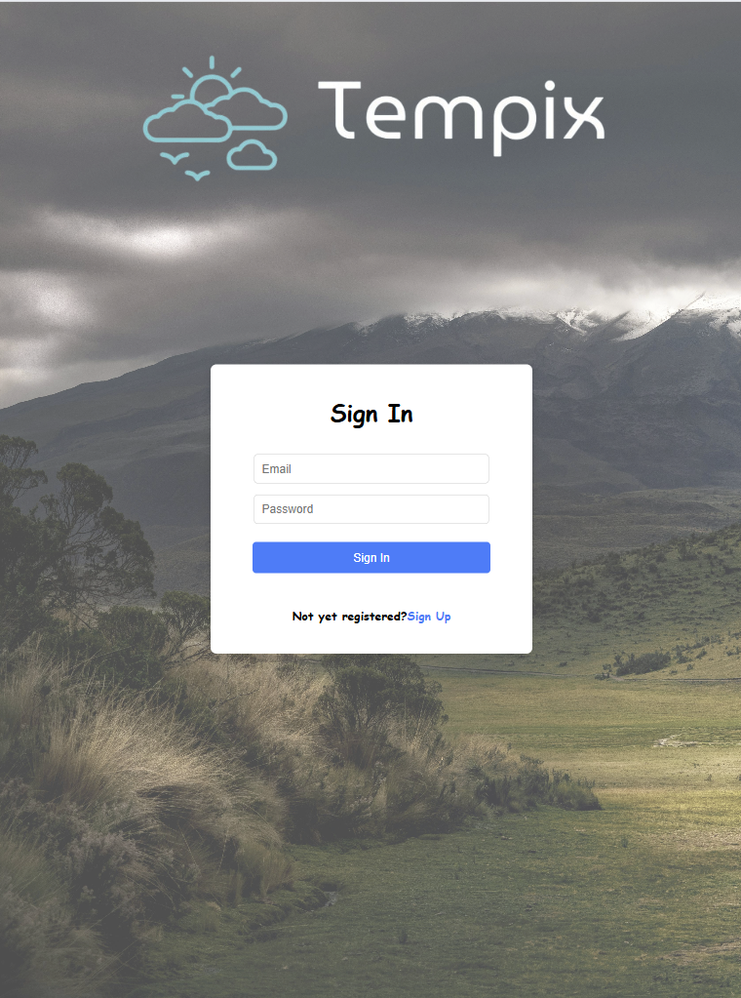

Project Tempix – a weather app
For DEV 209
Created by Henadzi(Henry) Kirykovich and Oleksandra(Sasha) Skvortsova

Slide 2
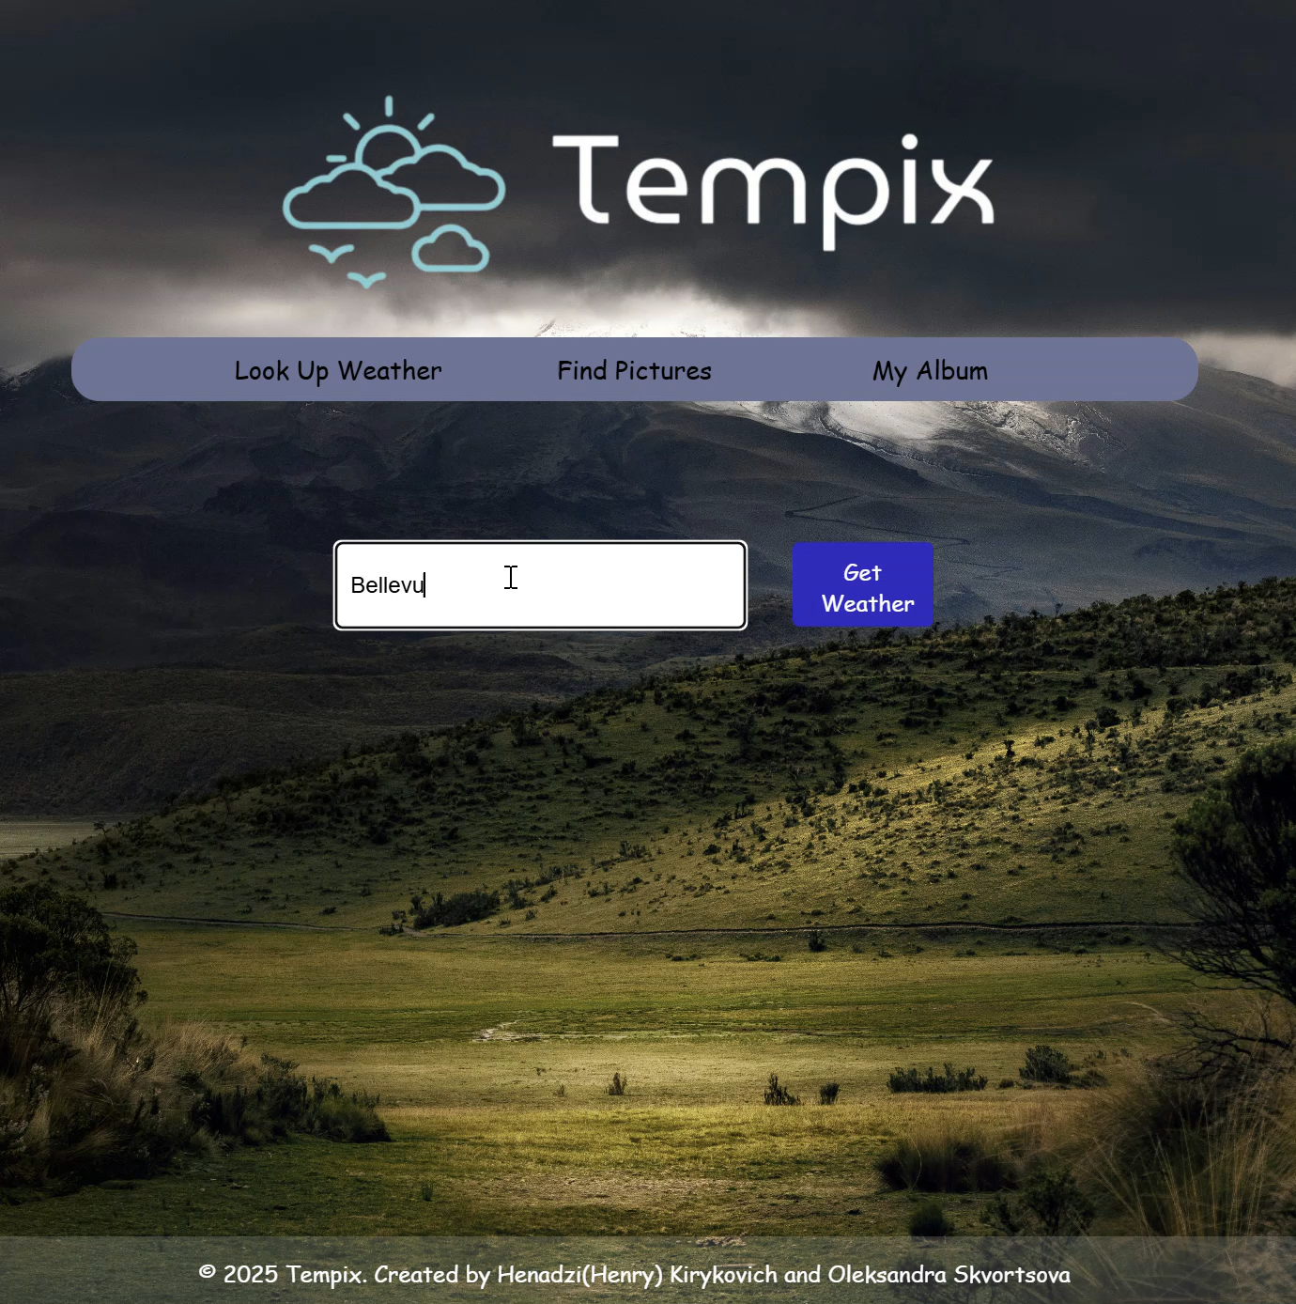
Overview
The proposed system is a multi-page React web application designed to facilitate user authentication, weather data retrieval, and favorite city management. It is a small prototype accessible on multiple platforms using any modern web browser. The application is fully responsive, supporting mobile (320px), tablet (768px), and desktop (1024px+) resolutions. It provides an interactive and engaging user experience for checking the weather and enjoying city views.
The application integrates APIs for weather forecasting and image retrieval, ensuring a dynamic and responsive user interface. Users can search for weather information, view city images, and manage a list of favorite locations. The project showcases best practices in modern web development, including authentication workflows, API integration, and responsive UI design.

Slide 3
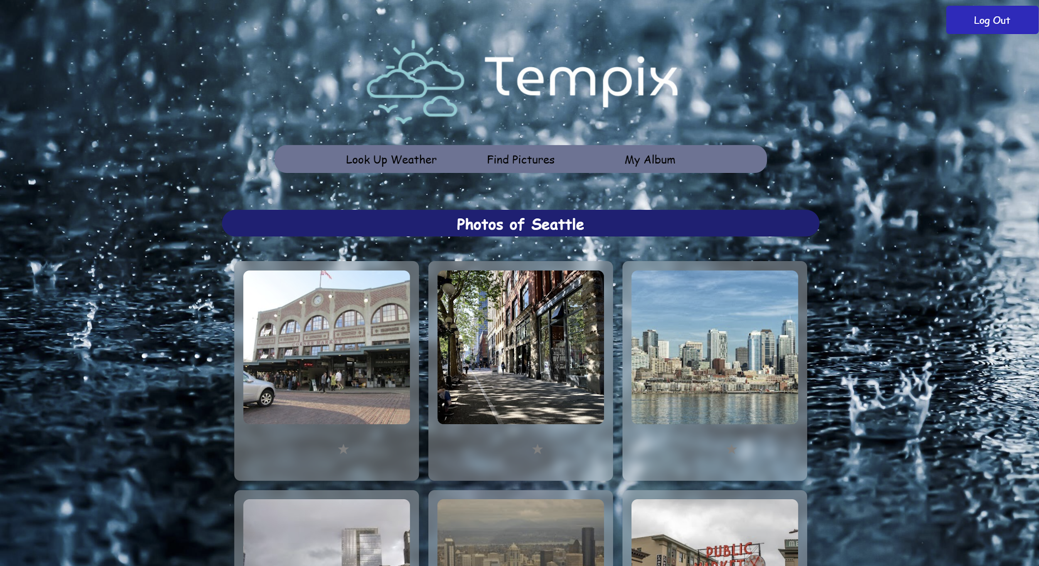
Laptop View

Slide 4
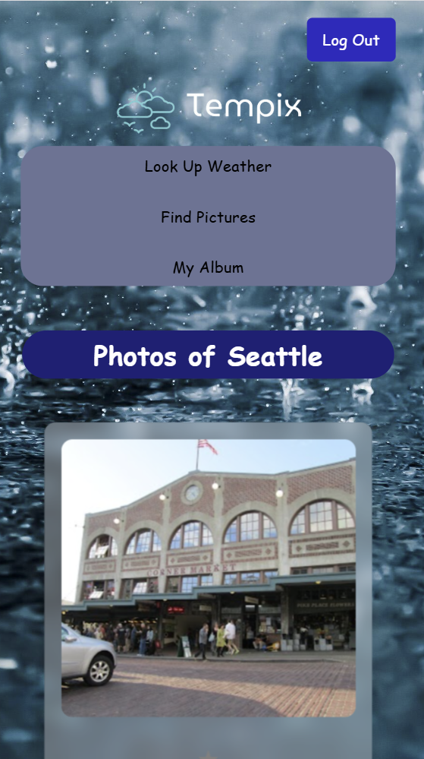
Phone View

Slide 5
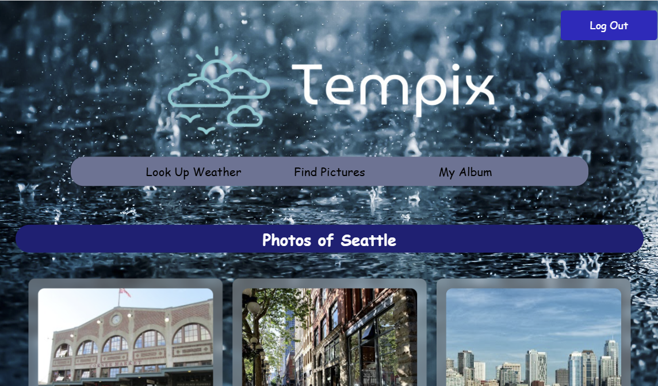
Tablet View

Slide 6
Technical Specifications
Frontend Architecture: Developed using React.js, leveraging React Router for seamless multi-page navigation.
Semantic HTML5: Utilizes ARIA-compliant markup for enhanced accessibility and structural clarity.
Responsive UI: Implements CSS Grid and Flexbox for adaptive layout across various screen resolutions.
API Integration: Supports asynchronous data retrieval with loading states and error handling.
State Management: Utilizes React Hooks for efficient global state handling.
Security Measures: Ensures authentication security via Firebase.

Slide 7
Key Approaches Used in Authentication
In this authentication system, Firebase Authentication is used to manage user sign-up and sign-in. The key approaches used include:
// References for email and password input fields
const emailRef = useRef(null);
const passwordRef = useRef(null);
// State to toggle between Sign Up and Sign In mode
const [isSignUp, setIsSignUp] = useState(false);
// Hook for navigation after authentication
const navigate = useNavigate();
React Hooks & Refs for Form Handling
useRef is used to reference email and password input fields, improving efficiency and avoiding unnecessary re-renders.
useState is used to toggle between Sign In and Sign Up modes dynamically.
Firebase Authentication for User Management
createUserWithEmailAndPassword: Creates a new user account in Firebase.
signInWithEmailAndPassword: Authenticates existing users.
Firestore Integration for User Data Storage
Upon successful sign-up, user data (email and creation date) is stored in Firestore using setDoc.
Navigation Control with useNavigate
After authentication, users are redirected to the weather page using React Router's useNavigate().
Error Handling & Alerts
Try-catch blocks handle authentication errors and provide user-friendly alerts.
Toggle function to switch between Sign In and Sign Up
<button type="submit">{isSignUp ? 'Sign Up' : 'Sign In'}</button>
{/* Toggle between Sign In and Sign Up */}
<h4>
{isSignUp ? "Already have an account?" : "Not yet registered?"}
<span onClick={() => setIsSignUp(!isSignUp)} className="signin_link">
{isSignUp ? "Sign In" : "Sign Up"}
</span>
</h4>

Slide 8
Key Approaches in Layout.jsx
1) User Authentication & Logout Handling
Uses Firebase Authentication to manage user sessions.
signOut(auth) logs out the user and redirects them to the sign-in page.
2) Navigation System Using React Router
Utilizes React Router’s <Link> component for seamless page transitions.
<Outlet /> dynamically renders the content of the selected route.
3) Consistent UI Structure Across Pages
Fixed elements: 1) Navigation Bar 2) Application Logo 3) Footer
Ensuring secure session management with Firebase Auth (for Logout button):
const handleSignOut = () => {
signOut(auth)
.then(() => {
console.log("User signed out");
navigate("/"); // Redirect to the sign-in page after logout
})
.catch((error) => console.error("Error signing out: ", error));
};
{/* Navigation Bar */}
<nav className="navbar">
<Link to="/layout/weather">Look Up Weather</Link>
<Link to="/layout/pictures">Find Pictures</Link>
<Link to="/layout/my-album">My Album</Link>
</nav> {/* Main content section where child components will be rendered*/}
<div className="main-content">
<Outlet /> {/* Displays the currently active route */}
</div>

Slide 9
Fetching Place ID & City Photos with Google Places API
Key Features of the Code:
Retrieves a city’s Place ID using Google Places Autocomplete API.
Fetches city photos using the Google Places Details API.
Handles API errors gracefully to prevent crashes.
Uses a CORS proxy (cors-anywhere.herokuapp.com) to bypass CORS restrictions.
export const getCityPhotos = async (cityName) => {
// Retrieve place ID first
const placeId = await getPlaceId(cityName);
if (!placeId) return [];
const PHOTO_DETAILS_URL = `${CORS_PROXY}https://maps.googleapis.com/maps/api/place/details/json?place_id=${placeId}&fields=photos&key=${API_KEY}`;
try {
console.log(`Fetching photos for place ID: ${placeId}`);
console.log(`Requesting: ${PHOTO_DETAILS_URL}`);

Slide 10
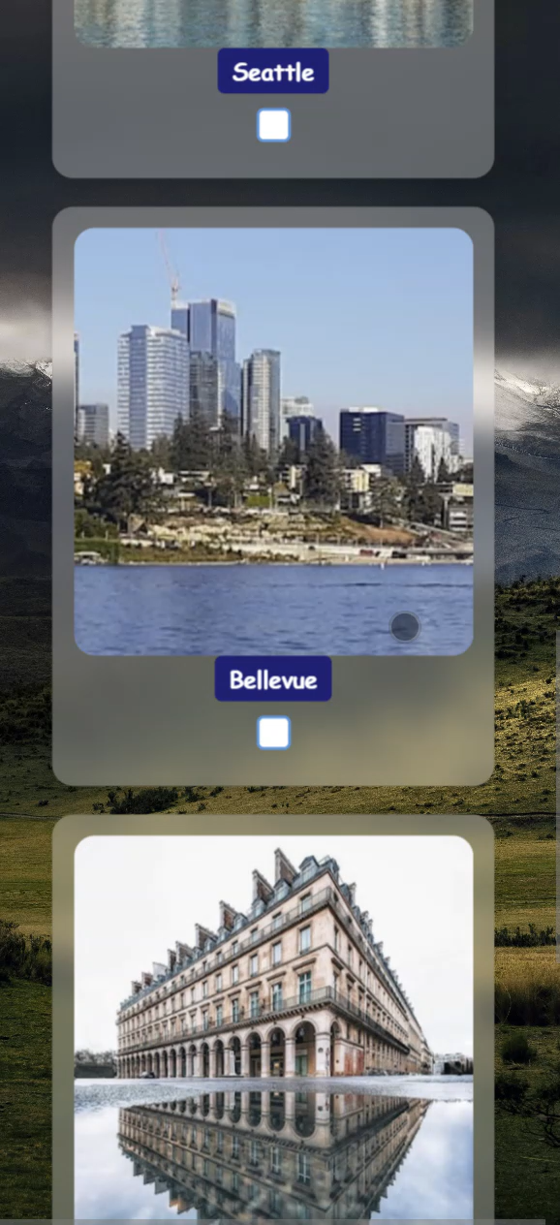
My album Component
Fetching and Displaying User Photos
When a user visits the My Album page, the app fetches their saved photos from Firebase Firestore.
It retrieves photos stored in albums associated with the authenticated user.
Explanation:
The fetchPhotos function retrieves all albums linked to the user.
It loops through albums and fetches photos stored in each one.
Retrieved photos are stored in the state and displayed in the UI.
const fetchPhotos = async (userId) => {
setLoading(true);
if (!userId) {
console.error("No user logged in!");
setLoading(false);
return;
}

Slide 11
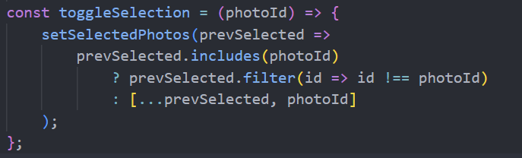
Selecting & Deleting Photos Users can select multiple photos using checkboxes. Clicking "Delete Selected" removes the chosen photos from both Firestore and the UI.
Sorting Photos Alphabetically
Users can sort photos by city name using the "Sort Alphabetically" button.
const sortPhotos = () => {
setPhotos((photos) =>
[...photos].sort((a, b) => a.city.localeCompare(b.city))
);
};

Slide 12
useState – Managing Component State
const MyAlbum = () => {
// State to store fetched photos
const [photos, setPhotos] = useState([]);
// State to track selected photos for deletion
const [selectedPhotos, setSelectedPhotos] = useState([]);
// State to manage loading status
const [loading, setLoading] = useState(false);
How It Works
photos holds the list of images fetched from Firestore.
selectedPhotos tracks which photos the user selects for deletion.
loading helps display a loading state while fetching images.

Slide 13
useEffect – Fetching Data on Component
Mount and Route Change
useEffect(() => {
if (auth.currentUser) {
fetchPhotos(auth.currentUser.uid);
} else {
console.log("User not authenticated yet.");
}
}, [location]);
The useEffect hook is used to trigger side effects, such as fetching data when the component is first rendered or when the route changes.

Slide 14
Google API Restrictions
If the proxy is down, Google API requests may fail. Switching to corsproxy.io or setting up a backend proxy is recommended. OpenWeather API updates data every few minutes, so real-time data may not always be 100% accurate.

Slide 15

Tempix is a modern, feature-rich weather application that provides real-time weather updates for any location worldwide, including famous cities. In addition to weather forecasts, Tempix enhances your experience with:
Stunning images of selected cities, Music that adapts to the current weather and Google Authentication for personalized access Google Autocomplete for easy location search

Slide 16
Thank you for attention!

